Slide 1



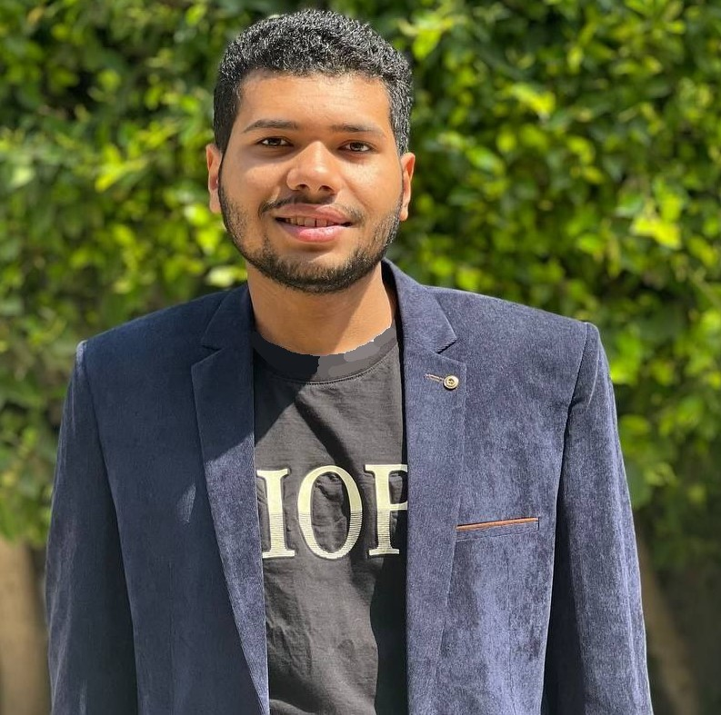
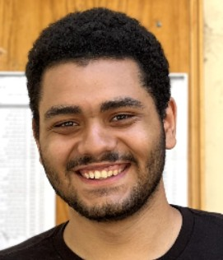
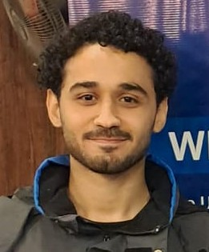
Aqua Vision
Integration of IoT Technology with AI in Egypt's Aquaculture Industry
Supervision: Dr. Samah El-Shafiey
Presented by: Yousef Khaled | Ameer Louly | Mohamed Ahmed

Slide 2




TABLE OF CONTENTS
01.
INTRODUCTION
02.
Problem Definition
03.
Methodology
04.
Implementation
05.
06.
Experimental Results
Conclusion & Future Work

Slide 3





01.
INTRODUCTION

Slide 4


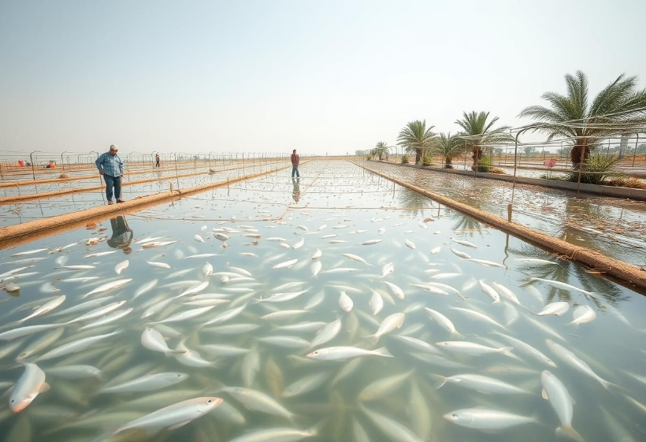




01. INTRODUCTION
- Growing sector vital to Egypt’s economy and food security[1]
75% of Egypt’s total fish production
- Issues: manual monitoring, high mortality, inefficient
resource use[2]
30% fish mortality rates
- Aqua Vision: smart IoT and AI-based aquaculture optimization system

Slide 5
02.
Problem Definition

Slide 6

02.Problem Definition
Manual Monitoring
No Real-Time Adaptation
Fixed Threshold
Time-consuming, prone to human error
Delayed response causes fish stress and mortality
Inefficient across seasons and fish growth stages

Slide 7

Methodology

Slide 8


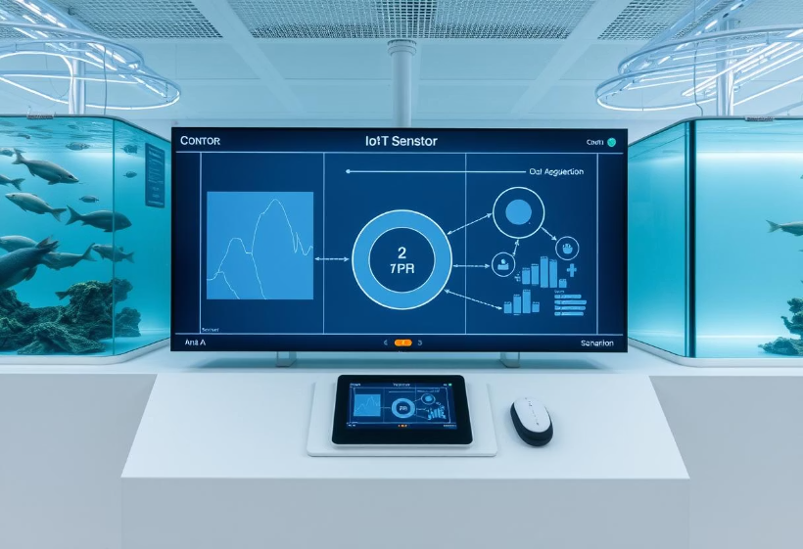

Methodology
Sensor’s Data
Components
Algorithm
AI Module

Slide 9
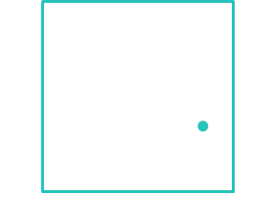
Implementation

Slide 10

Implementation
Hardware
Software
2 ESP 32 microcontroller for Transmit and receive
Ph, Temperature, DO, Water level sensors
Data acquisition via sensors then analysis for taking decision

Slide 11
Algorithm
Data acquisition
Receive and analyze
AI Decide
Transmit Data
Compare the data with AI threshold

Slide 12
5
Experimental Results

Slide 13
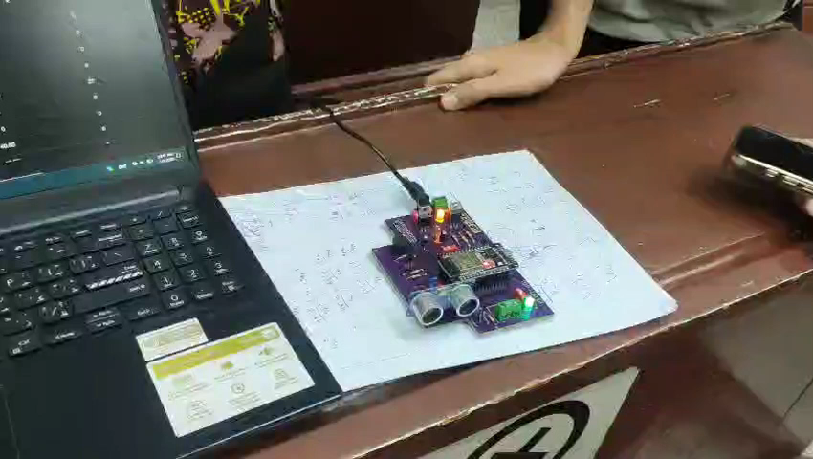
Testing Prototype
A demo video for the Prototype

Slide 14
Key Results

Slide 15



Conclusion and Future Work

Slide 16
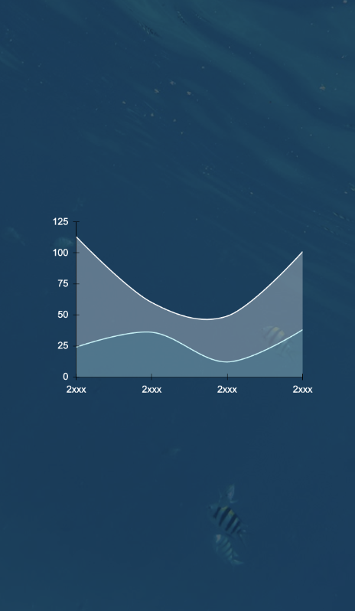
Conclusion
IoT and AI integration boosts smart aquaculture
Enhances monitoring, cost efficiency, sustainability

Slide 17

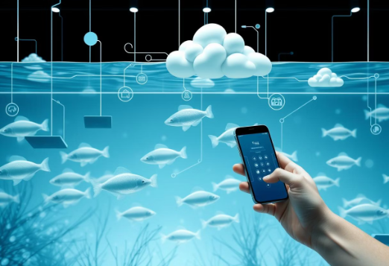
Cloud and mobile remote management
Expand AI training with field data
Deploy on real Egyptian fish farms
Future Work

Slide 18
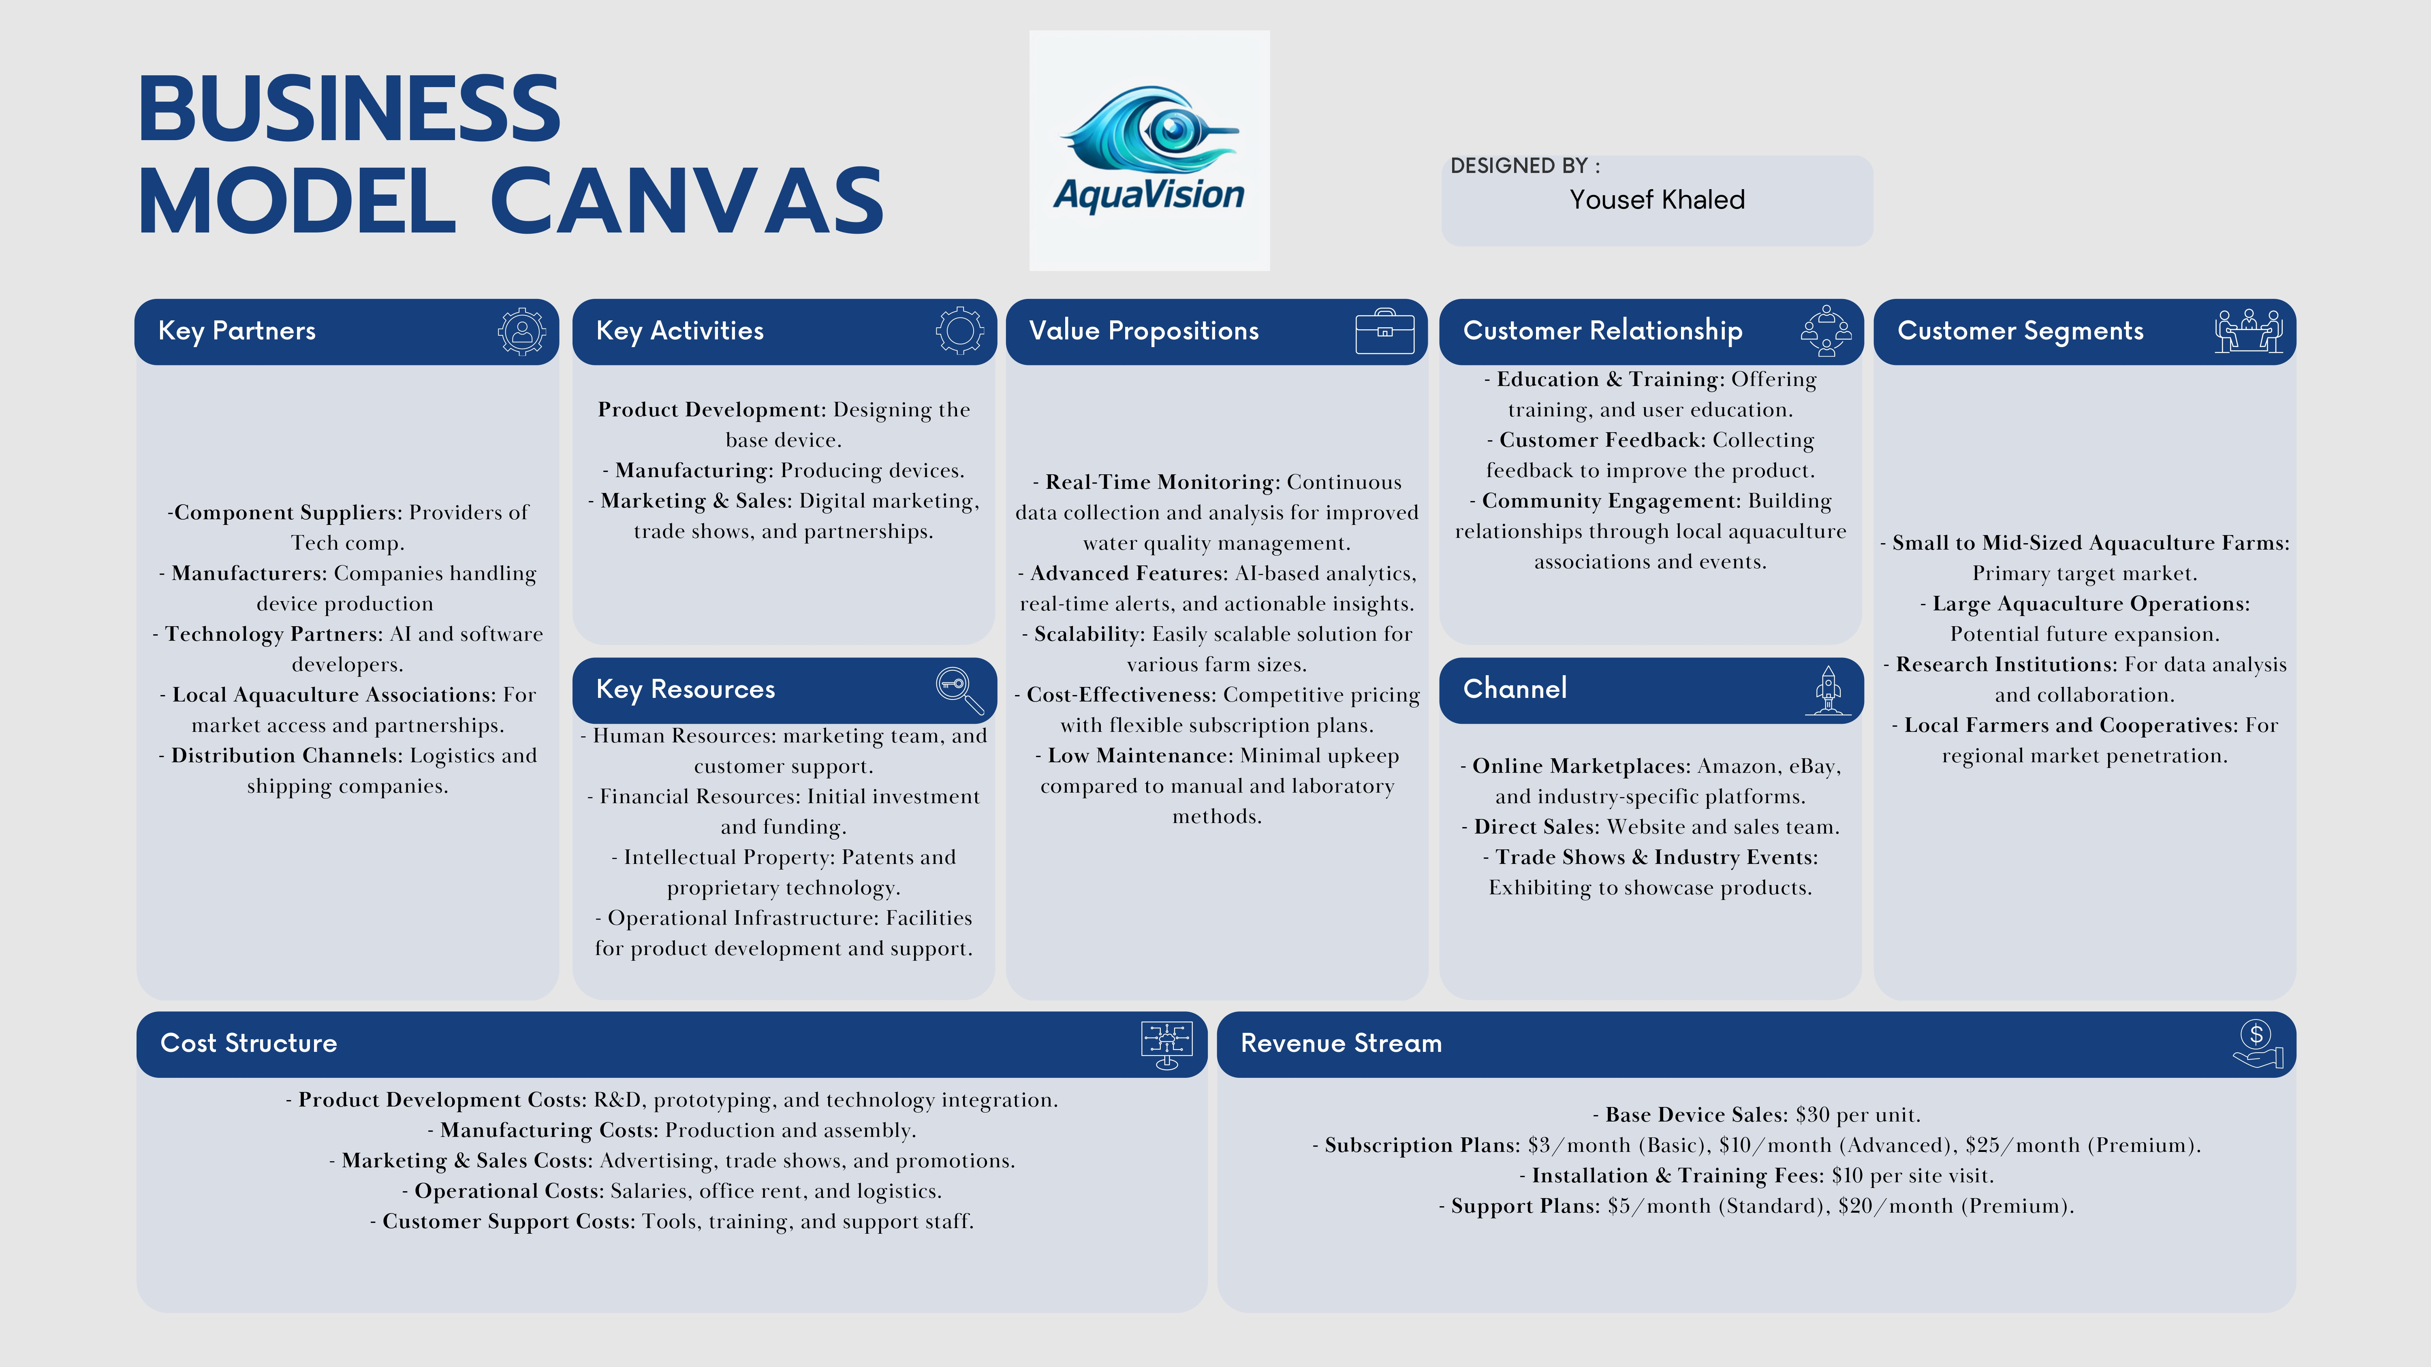

THANKS!
Do you have any questions?

Slide 19
THANKS!
Do you have any questions?

Slide 20
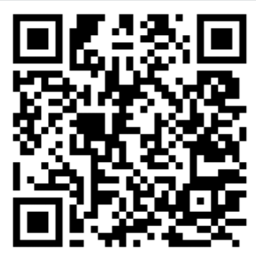
QR Code

